Slide 1

Predicting Football RESULTS Using ML techniques
By Kontham Akhilesh(18311A1925)
Katta Rakesh (18311A1921)
Anil Kumar Rapolu (18311A1945)
This Photo by Unknown author is licensed under CC BY-SA.

Slide 2
Abstract
Predicting the results of football matches poses an interesting challenge due to the fact that the sport is so popular and widespread. However, predicting the outcomes is also a difficult problem because of the number of factors which must be taken into account that cannot be quantitatively valued or modeled.
Modern methods for processing data, in combination with strong computational power of computers, allow us to predict the results of the next matches by applying machine learning algorithms on collected data.
This Photo by Unknown author is licensed under CC BY-SA.

Slide 3
Introduction
Sporting is one of the most followed events in the world and Football tops the list.
Football sometimes referred to as soccer.
The Football world cup which takes place every 4 years comes with a lot of surprises.
In 2010 Football world cup, an octopus was able to predict the winner of each match successfully.
The English Premier League is the most watched sports league in the world, being broadcast to 643 million homes in 212 territories and with a potential TV audience of 4.7 billion people.
This Photo by Unknown author is licensed under CC BY-SA.

Slide 4
INTRODUCTION
Prediction of Football match has always been something that fans tend to do before matches , be it for fun, enjoyment, etc…
various models are developed to predict the result of the matches.
current models estimate the results roughly with an accuracy of about 50%.
But the proposed model increases the accuracy by considering not only the statistical analysis of the players but also the few other match events.
The proposed model concludes the result by predicting whether a particular team wins or looses or match draws.
In recent times, the goals scored by teams are fewer as they are moving towards defensive approach.
This is an interesting area of research as Football is regarded as a complex and dynamic when compared to other sports.

Slide 5
Literature survey
The accuracy score is around 60% using Naive Bayes techniques, K-NN, Logistic Regression.
Able to predict the matches of UEFA Champions League, Dutch football team.
Lack of access to complete Datasets of EPL(English Premiere League).
They predict by considering only the few dataset features which may not give accurate results.
Inconsistent data features across the different datasets.

Slide 6
Existing system
There are different approaches used in football result prediction in existing systems, these include K-NN, Naive Bayes, Logical Regression, Bayesian Network Model.
Football predictive system is made up of two main components, namely: feature sets/ data sets and implementation techniques. We therefore analyse the data sets and the techniques used in the implementation of existing system.
Cons of Existing System: A number of techniques and feature sets have been used to develop and implement football results prediction systems. Due to the variations observed in these, it is difficult to identify which system outperforms the others. These variations include: number of goals prediction, win-draw-loss prediction, propensity to score or concede goals, total points earned in a season, etc.

Slide 7
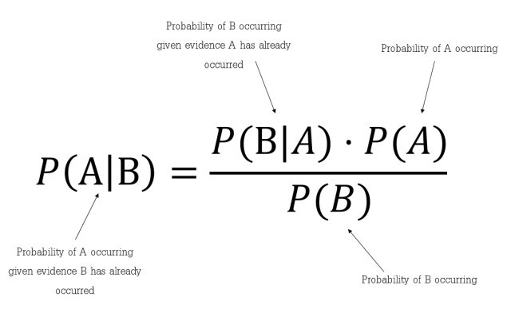
Existing system - ALGORITHMS
Using Naive Bayes Technique:
Step 1: Calculate the prior probability for given class labels
Step 2: Find Likelihood probability with each attribute for each class
Step 3: Put these value in Bayes Formula and calculate posterior probability.
Step 4: See which class has a higher probability, given the input belongs to the higher probability class.
Disadvantages:
Naive Bayes assumes that all predictors (or features) are independent, rarely happening in real life.
The Accuracy of the models build by using this technique is not up to the mark.

Slide 8
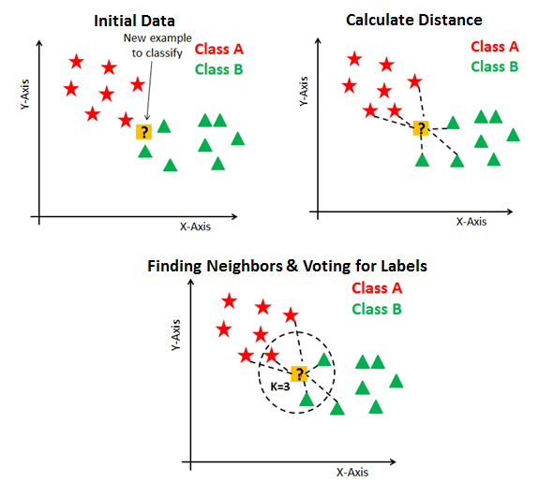
Existing system - ALGORITHMS
2. Using K-Nearest Neighbors:
Step 1: Calculates distance
Step 2: Find all the closest neighbors based on value of k
Step 3: Vote for labels
Disadvantages:
With large data, the prediction stage might be slow, and less Accurate.
KNN is sensitive to outliers and missing values

Slide 9
Proposed system
The proposed system would be implemented using three different Machine Learning Algorithms.
The model will be developed using a ML Technique with enhanced capabilities. which seeks to improve on the problems of implementation complexities and low prediction rate inherent in exiting systems.
Number of goals scored, Home team points, Away team points, Winning streak within a season, as well as other features used in the existing systems will be used to design and build the model.

Slide 10
Proposed system
To develop a Machine learning Algorithm or Technique that helps in predicting the match winning team in the football match with high Accuracy.
Model is developed by considering the following features:
Winning Streaks of the teams.
Based on the existing features.
Home team and away team goal difference.
DiffFormPts: Different form of points i..e, penalty, strike

Slide 11
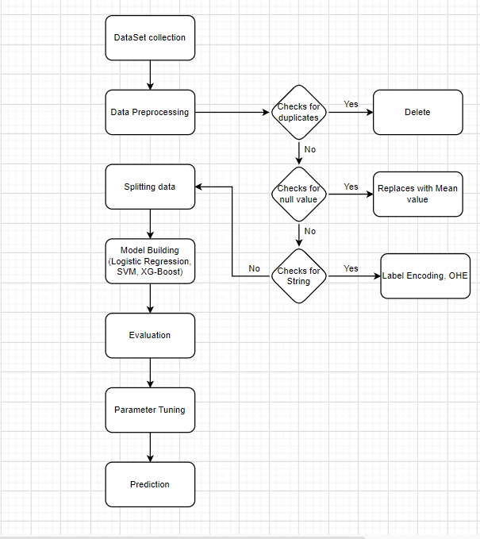
FLOW DIAGRAM

Slide 12
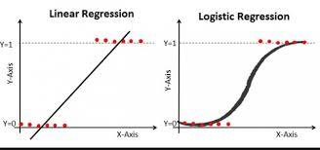
PROPOSED System - MODEL 1 (Logistic Regression)
It is used for the Binary classifiers.
Sigmoid function is developed an S-curve is constructed.
Overcomes the disadvantages of the Linear Regression i.e, Outliers

Slide 13
PROPOSED System - Algorithm 1 (Logistic Regression)
Step 1: Datasets are collected from previous football matches of English Premier League.
Step 2: Data pre-processing is done on the datasets to use the data for building the model.
Step 2.1: finding the null values, if any replace them with mean, median or mode.
Step 2.2: Removing the duplicate tuples.
Step 2.3: Label Encoding, converting the string datatypes to Numbers.
Step 2.4: One Hot Encoding, Creating the Dummy Variables from the categorical variable
Step 3: Splitting the data into training and testing sets. (70%, 30%)
Step 4: Model Building
Step 4.1: from sklearn.linear_model import LogisticRegression
Step 4.2: model=LogisticRegression(random_state=42)
Step 4.3: y_pred=model.predict(xtest)
Step 4.4: y_pred == ytest
Step 4.5: model_accuracy = numpy.mean(y_pred == ytest)
Step 5: Evaluating the accuracy of the model. (model_accuracy)
Step 6: Optimizing the model using the accuracy scores of different models.

Slide 14
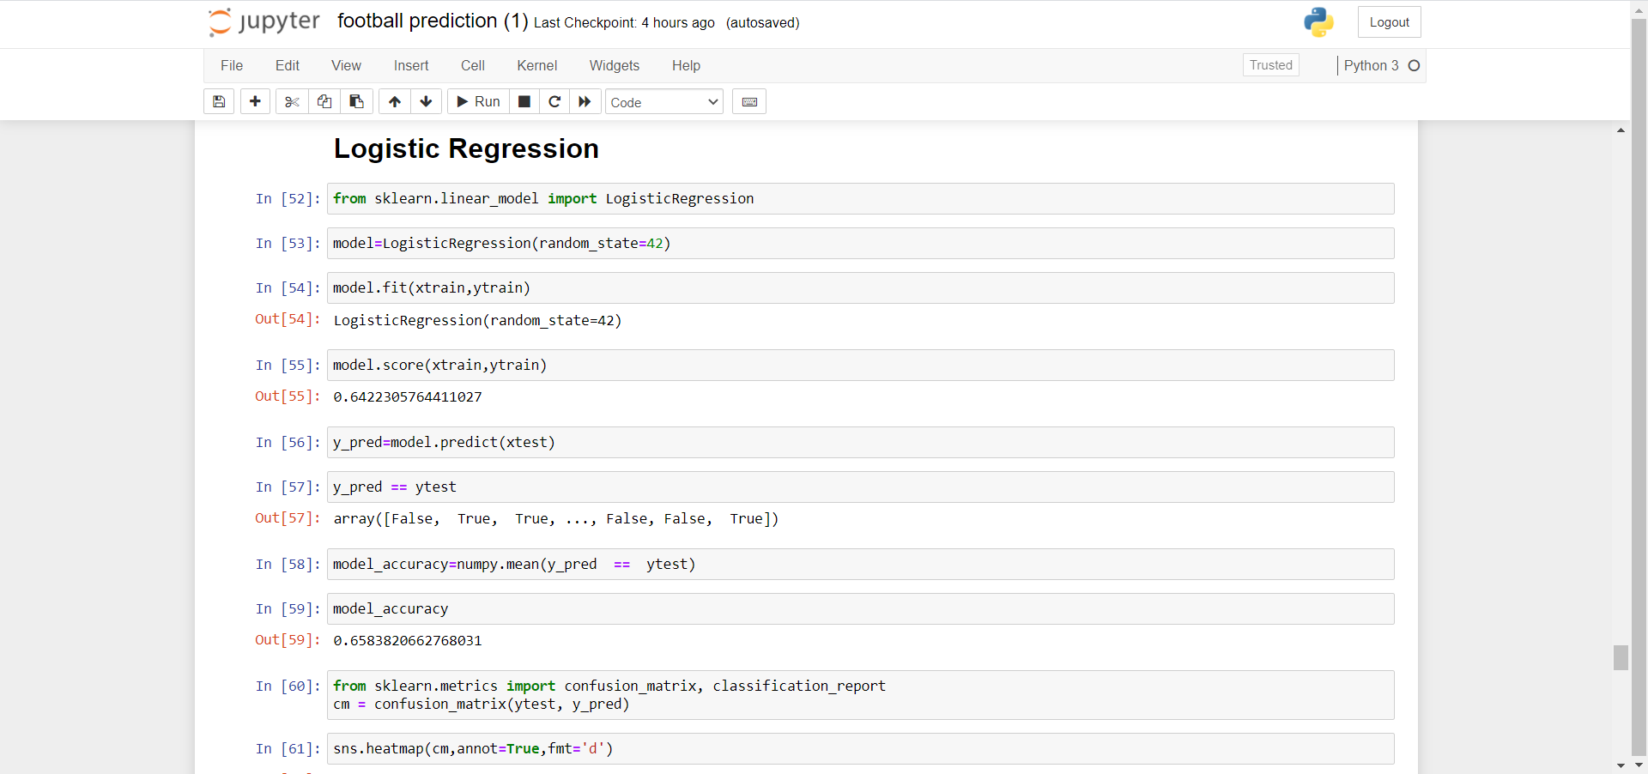
Implementation- Logistic Regression

Slide 15
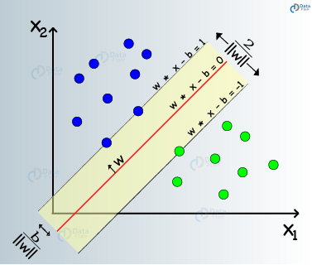
PROPOSED SYSTEM – MODEL 2 (Support Vector MACHINE)
SVM :Support Vector Machine
SVM is based on concept of decision planes that define decision boundaries.
A decision plane is one that separates between two sets of objects.
The decision plane is called as hyper plane which plays a key role.

Slide 16
PROPOSED SYSTEM – Algorithm 2 (Support Vector MACHINE)
Step 1: Datasets are collected from previous football matches of English Premier League.
Step 2: Data pre-processing is done on the datasets to use the data for building the model.
Step 2.1: Finding the null values, replace them with mean, median or mode (if any)
Step 2.2: Removing the duplicate tuples.
Step 2.3: Label Encoding, converting the string datatypes to Numbers.
Step 2.4: One Hot Encoding, Creating the Dummy Variables from the categorical variable
Step 3: Splitting the data into training and testing sets. (70%, 30%)
Step 4: Model Building
Step 4.1: from sklearn.svm import SVC
classifier = SVC(kernel='rbf',random_state = 1) //Radial basis function kernel
classifier.fit(xtrain,ytrain)
Step 4.2: y_pre = classifier.predict(xtest)
Step 4.3: SVM_accuracy=numpy.mean(y_pre == ytest)
Step 5: Evaluating the accuracy of the model. (SVM_accuracy)
Step 6: Optimizing the model using the accuracy scores of different models.

Slide 17
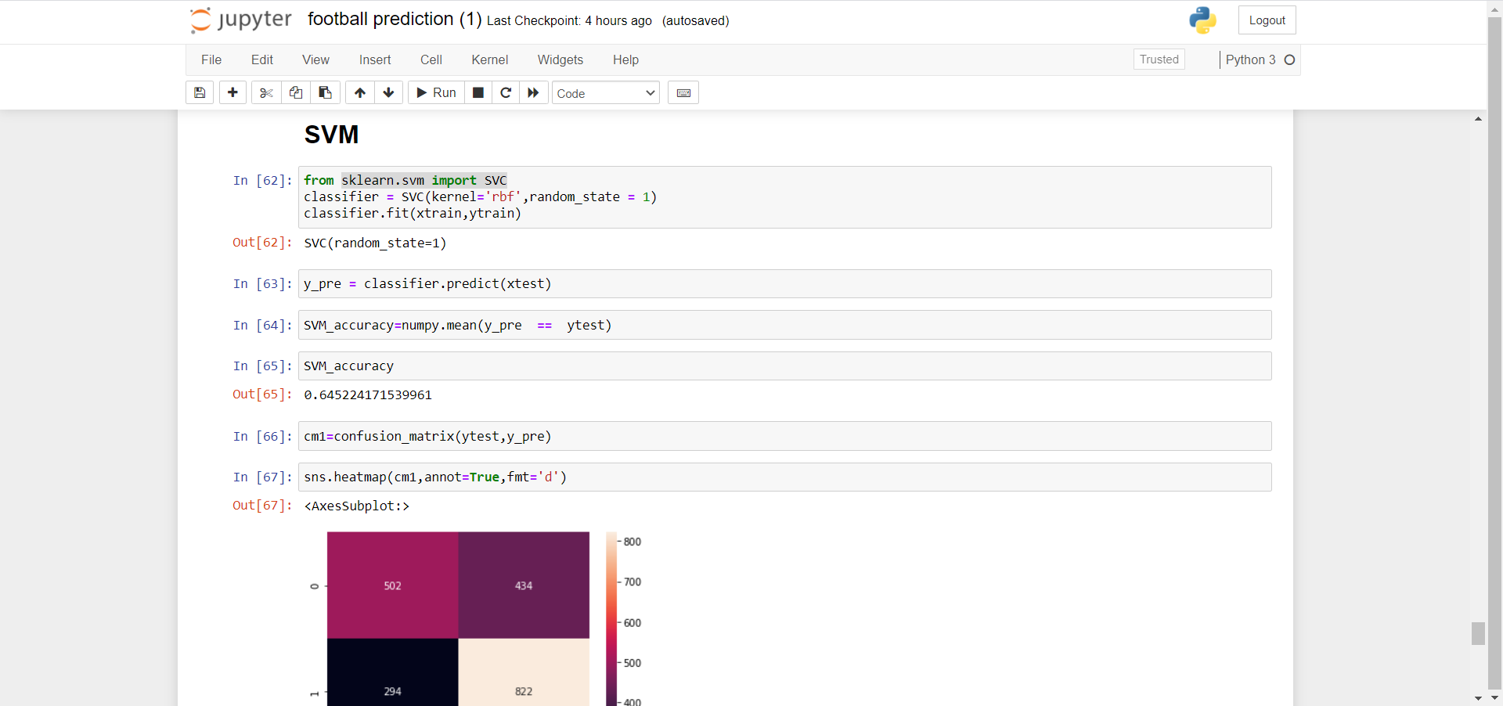
Implementation- SVM

Slide 18
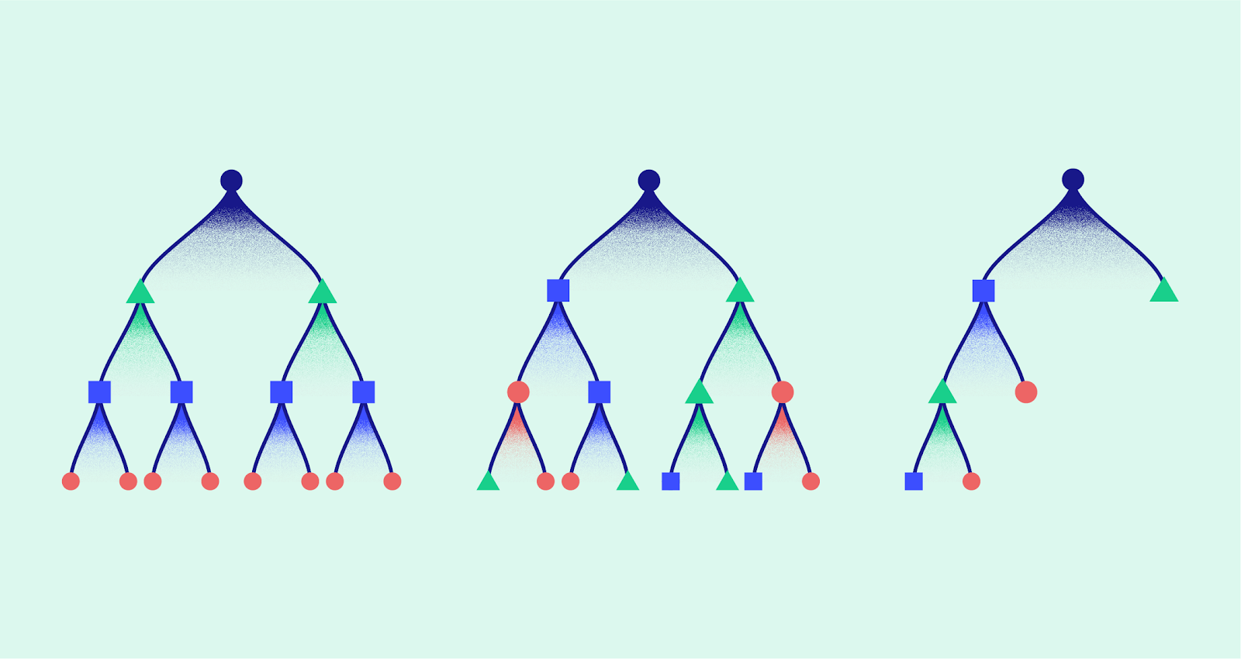
PROPOSED System - MODEL 1 (xg boost)
XG-Boost stands for eXtreme Gradient Boosting.
Base model is constructed first.
Calculate the residuals of each individual tuple.
Construction of binary tree with each attribute in the dataset.
Weights is calculated based on sum of residuals and the whole weight.
Decision is made and the prediction is explored

Slide 19
PROPOSED SYSTEM – ALGORITHM 3 (xgBoost)
Step 1: Datasets are collected from previous football matches of English Premier League.
Step 2: Data pre-processing is done on the datasets to use the data for building the model.
Step 2.1: Finding the null values, replace them with mean, median or mode (if any)
Step 2.2: Removing the duplicate tuples.
Step 2.3: Label Encoding, converting the string datatypes to Numbers.
Step 2.4: One Hot Encoding, Creating the Dummy Variables from the categorical variable
Step 3: Splitting the data into training and testing sets. (70%, 30%)
Step 4: Model Building
Step 4.1: from xgboost import XGBClassifier
classifier1=XGBClassifier(seed=82)
classifier1.fit(xtrain,ytrain)
Step 4.2: ypred=classifier1.predict(xtest)
Step 4.3: XGboost_accuracy=numpy.mean(y_pre == ytest)
Step 5: Evaluating the accuracy of the model. (XGboost_accuracy)
Step 6: Optimizing the model using the accuracy scores of different models.

Slide 20
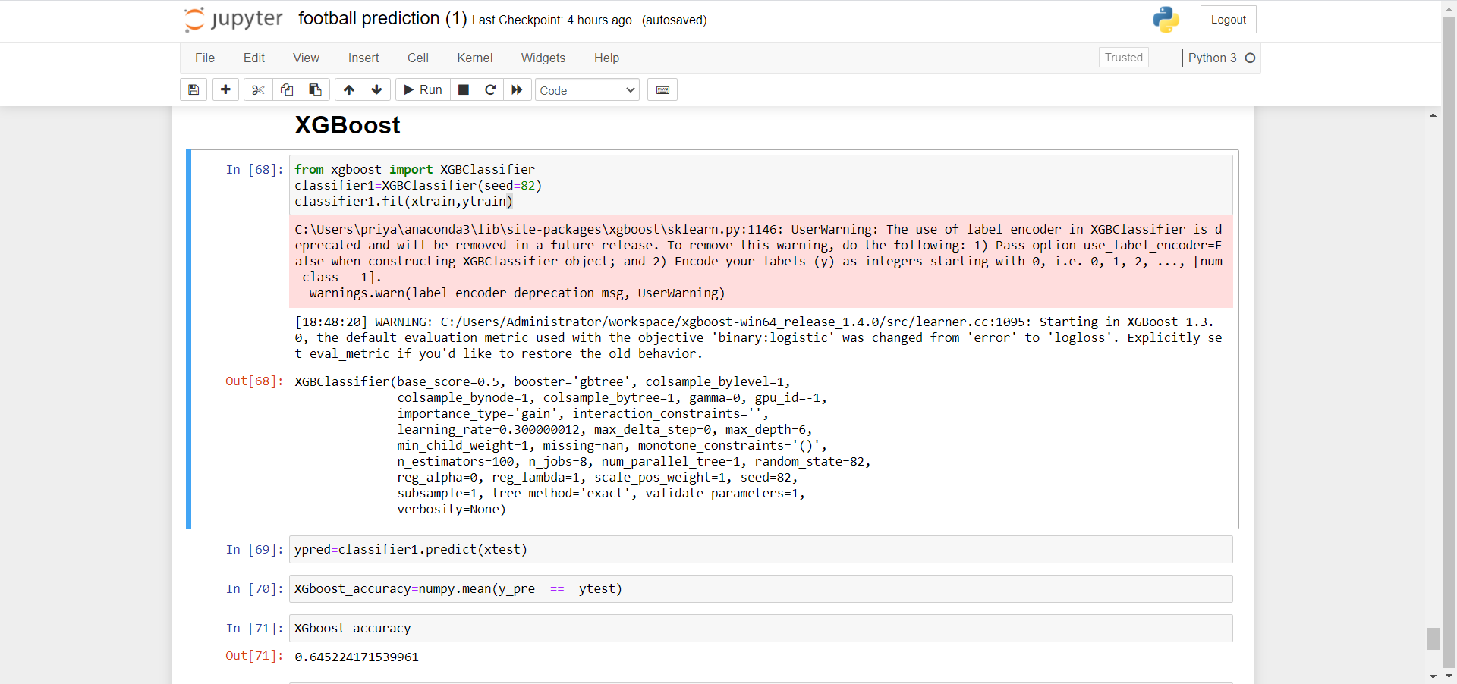
Implementation- XG Boost

Slide 21
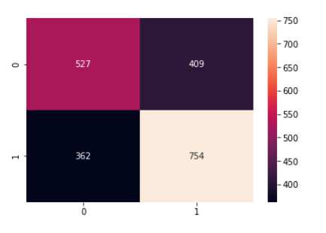
results
By using Logical Regression algorithm the accuracy is about 65.8%
By using SVM algorithm the accuracy is about 64.5%
By using XG-Boost algorithm the accuracy is about 69.75%

Slide 22
Comparison of results
Existing models
Proposed models(before tuning)
Logistic Regression Accuracy: 60%
Naive Bayes Algorithm Accuracy: 64%
K-NN Algorithm Accuracy: 58%
Logistic Regression Accuracy: 65.8%
XG-Boost Algorithm Accuracy: 69.7%
SVM Algorithm Accuracy: 64.5%

Slide 23
Conclusion and future scope
The model developed is based on statistical analysis of past football games.
Able to make more fairly accurate predictions.
Although the accuracy of this model is pretty good, it's not guaranteed to be always right.
This can be further developed by considering the trending hash-tags on twitter on match day.

Slide 24
references
[1] Hucaljuk, J & Rakipović, A. (2011). Predicting football scores using machine learning techniques. 2011 Proceedings of the 34th International Convention MIPRO,, 1623-1627.
[2] Abel Hijmans. Dutch football prediction using machine learning classifiers (unpublished)
[3] T. Cheng, D. Cui, Z. Fan, J. Zhou, and S. Lu, “A new model to forecast the results of matches based on hybrid neural networks in the soccer rating system,” Proceedings Fifth International Conference on Computational Intelligence and Multimedia Applications. ICCIMA 2003.
[4] R.K. Balla, "Soccer Match Result Prediction using Neural Networks" in
[5] Farzin, O., Parinaz, E., &Faezeh, S. M. Football result prediction with Bayesian network in Spanish league-Barcelona team. International Journal of Computer Theory and Engineering, 5(5), 2013, 812-815
[6] Darwin, P & Dra, H (2016). Predicting Football Match Results with Logistic Regression. 2016 International Conference On Advanced Informatics: Concepts, Theory And Application (ICAICTA).
[7] G. Baio and M. Blangiardo. "Bayesian hierarchical model for the prediction of football results." University College London Department of Statistical Sciences, Gower Street, London WC1 6BT
[8] N. Tax and Y. Jousts. "Predicting The Dutch Football Competition Using Public Data: A Machine Learning Approwh."
[9] Baboota, Rahul & Kaur, Harleen. (2018). Predictive analysis and modelling football results using machine learning approach for English Premier League. International Journal of Forecasting. 35. 10.1016/j.ijforecast.2018.01.003.
[10]D. Prasetio and D. Harlili, "Predicting football match results with logistic regression," 2016 International Conference On Advanced Informatics: Concepts, Theory And Application (ICAICTA), George Town, 2016, pp. 1-5.

Slide 25
Thank you

